Slide 1
SESSION THREE –CLEAR INSTRUCTIONS

Slide 2
CLEAR INSTRUCTIONS
Instead of saying ‘don’t’ say ‘please’
Children need time to process requests
Make commands short and to the point
Break the commands down in to simple steps
Support your partner’s commands
Praise when tasks are complete / attempted
Notes:
When giving instructions to our children we need to ensure that what we're saying is clear and children understand what we are asking them to do we also need to allow them processing time firstly time to process what we have asked and then time to complete the task children can take anything from 5 to 30 seconds to understand and process what has been asked given before they start to carry it out.
Rather than saying get ready for school breaking it down into smaller steps like brush your teeth and wash your face, once they have compiled that then the next task of get dressed, which can be broken down further if necessary.
Telling a child ‘no’ does not tell them what we do what them to actually do – be specific! Describe exactly what you want to hear, see and by when.

Slide 3
FIRST … THEN YOU CAN …
Tidy your room
Do your homework
Eat your dinner
Go on your Xbox
Go to the park
Have some pudding
Notes:
A good way of giving clear commands is using first and then, this is a clear way of asking children to do something and they respond well when used correctly.
We can use this when our children want something but we must ensure we are consistent with the rules we use.
It also works well with giving instruction, first hang your coat up then put your bag away.
Remember to use praise when children have done as asked and keep your side of the bargain!

Slide 4
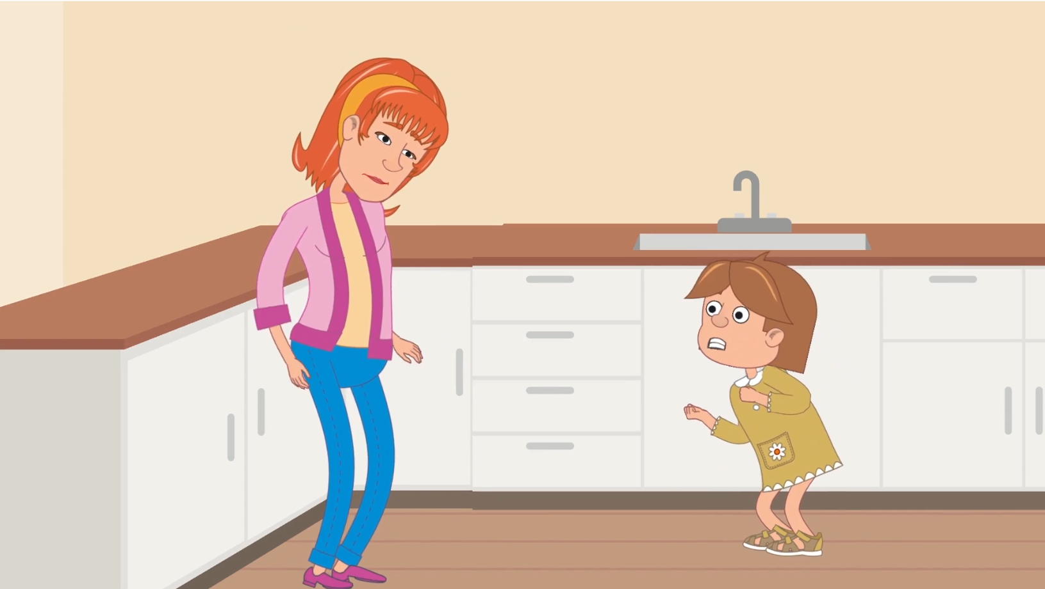
WHY ISN’T IT WORKING?
Notes:
Please add an animation image here showing ineffective relationship between parent and child
Let’s now take a look at why relationship sometimes breaks down between parent and child and results in bad behavious.

Slide 5
UNCLEAR / VAGUE COMMANDS
Let’s …
Why don’t we …
Don’t …
Wouldn’t it be nice to …
Be good / careful
Stop
Let’s not do that anymore
Notes:
These are some commonly used unclear and vague commands, saying things like let's do this, why don't we, wouldn't it be nice, is not telling the child what you want them to do it's a suggestion and children often take things literally – they need to be sure of what you mean.
Stop commands also don't let the child know what they can do, telling a child to walk rather than stop running is clear and lets them know exactly what you want.
If you ask a child to be good, nice or careful, how do they know what that means? Be specific, eg, remember to use the zebra crossing or please say thank you at the shops

