Slide 1

WEEK 2: Emotions and Resilience

Slide 2

Why do we need emotions?
Emotions let us know what to do in situations
They help us to avoid danger, or a potential threat
They motivate us to act
They clue us in on our likes and dislikes
They help others to understand us and what we feel
  (expressions, body language and words)
They are crucial to effective communication
  (verbal and non-verbal cues)
Notes:
Emotions can sometimes be the cause of arguments and unwanted behaviour but it is important to remember that emotions are natural, healthy and needed.
Emotions help us with managing situations including avoiding danger or potential threat, they help other to understand what we feel and help with effective communication.
Yes, children might sometimes need help managing their big emotions but we should never expect them to supress them.

Slide 3
Why teach children about emotions?
Helps children learn to recognize their own emotions
Helps the logical part of their brain take charge
Over time their logical brain calms their emotional brain down
Don’t try to teach them while they are in the middle of a melt-down!
Use stories, or images from the Parenting Workbook
Notes:
Emotions can sometimes be the cause of arguments and unwanted behaviour but it is important to remember that emotions are natural, healthy and needed.
Emotions help us with managing situations including avoiding danger or potential threat, they help other to understand what we feel and help with effective communication.
Yes, children might sometimes need help managing their big emotions but we should never expect them to supress them.

Slide 4
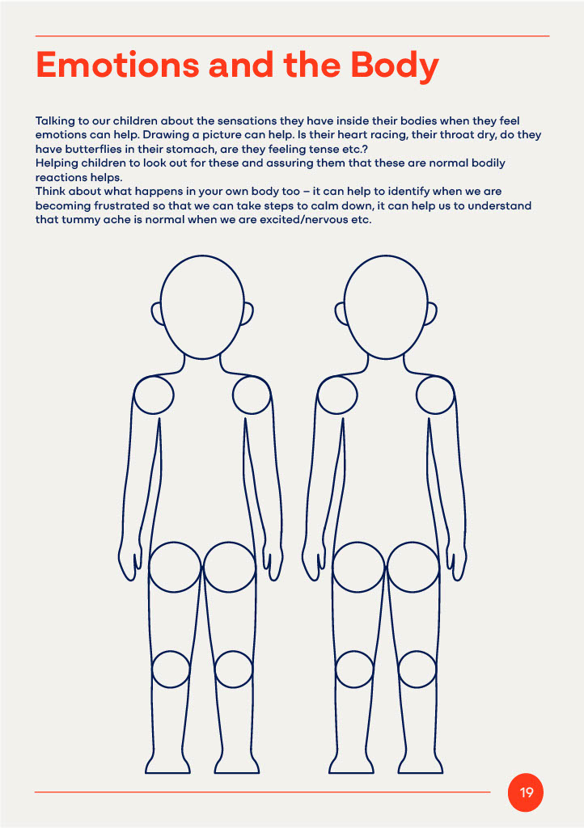
Notes:
To help parents recognise and manage emotions in themselves and their children we need to first understand the different emotion and how they individually affect us.
When we are angry we may feel hot and unable to think clearly, when we are excited we may feel unable to keep still and speak fast.

Slide 5
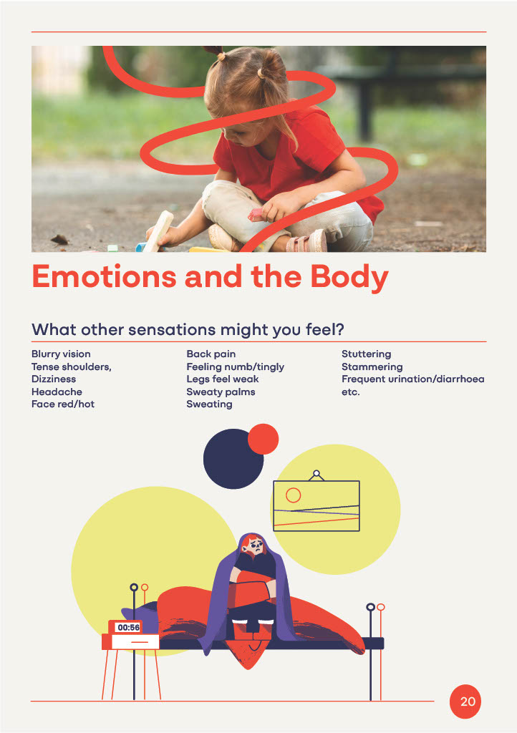
Notes:
This is an example of what someone may be feeling when worried or anxious. It might be helpful to explore with parents how their bodies respond to the emotions of fear, frustration and worry. This will help them to empathise with their children’s emotions too.

Slide 6
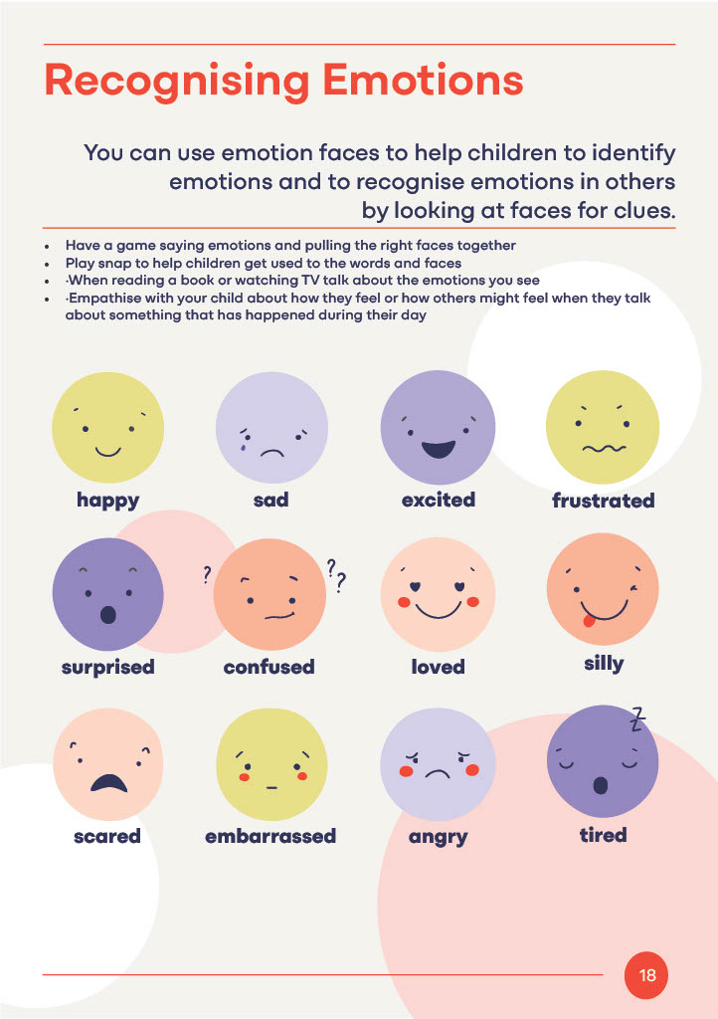
Notes:
Here are some examples of emotions that we may go through or feel regularly. It is helpful for parents to accurately name emotions with children so that they can better articulate how they are feeling and then manage that emotion effectively.

Slide 7
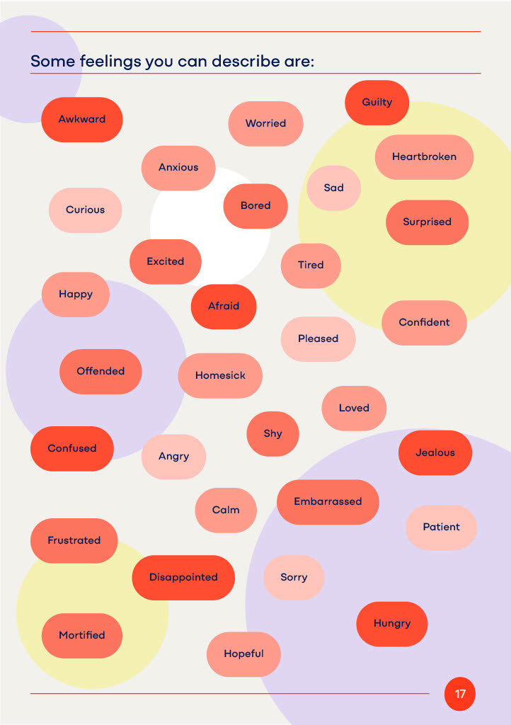
Notes:
Encourage parents to expand their vocabulary of emotions through play or commenting on characters feelings and behaviours when reading or watching TV with their children.

Slide 8
Emotional First Aid Kit
What makes you feel content?
Making a personal emotional first aid kit is important for us all
Everyone is different – think about yourself and ask your children what would work
When we have put one together it makes it easier to choose what to do to make ourselves feel right again
Thinking of many different things gives us choices in different situations
Notes:
Encourage parents to think about what helps them feel content - cup of tea, a walk, talking through things, hot bath, reading, gaming, these are just a few examples.
There are many things that can help in different situations and being aware of these help us build our own emotional resilience and support others with their emotions.
Being open with your child about your own emotions can provide a great role model for children, eg, ‘I feel really angry at the moment so I am going to take a walk in the fresh air to clear my head and make me feel better.’

