Slide 1

WEEK 4: Household rules and consequences
Notes:
This week we are going to discuss the best way to incentivise and reward positive behaviour and setting appropriate consequences for when set boundaries are broken.
We will also explore the difference between punishment and consequences and how boundaries and consequences can be used effectively to improve children’s behaviour without damaging the parent child relationship.

Slide 2

Home Rules
Rules help everyone to know what they are doing – football with no rules would not be fun, driving with no rules would be unsafe
Setting rules helps us to ensure that our children are kept safe and have fun
Get together as a family for a meeting
List the rules
Come up with consequences
Put them where everyone can see them
Review them now and again
Notes:
Rules help everyone know what they are doing and help keep us safe.
When setting home rules, allow the children to have their say on rules that are important to them, we may not always put these rules in place but giving our children a voice and knowing we have considered their suggestion is important.
Display the rules where they can be seen easily, with consequences clearly stated for if the rules are broken
Remember the rules apply to everyone in the home not just the children, if the children are not allowed phones at the table then you shouldn’t bring yours to the table either.

Slide 3
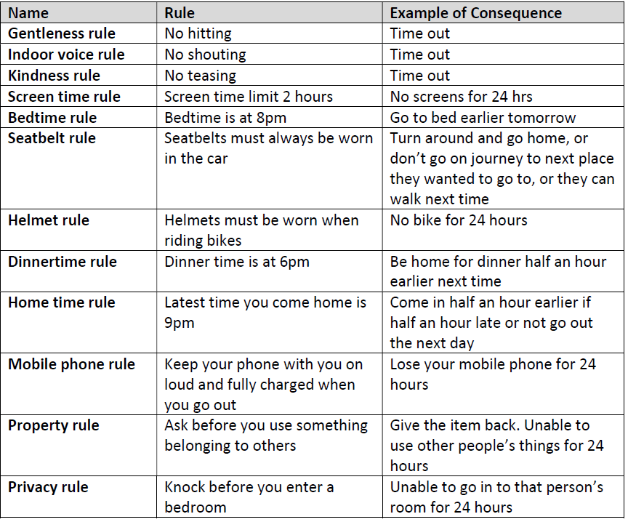
Some Examples of Rules
Notes:
examples of possible rules and consequence
Questions
is it ok to give instant rewards?
should we mark when our children have not reached the expected rewards?
should we put a consequence in place at home if school have already given a consequence?
do home rules apply to the parents?

Slide 4
Punishment vs Consequences
DO
use consequences rather than punishment
be respectful
DO NOT
humiliate or cause unnecessary suffering
involve shame, blame or pain
Punishment often results in the 4 Rs;
Resentment
Revenge
Rebellion
Retreat
Notes:
Suffering and humiliation are not requirements of consequences, the purpose is to change the misbehaviour and find a solution not to blame, shame or cause pain.
Punishment can often fracture a relationship between parent and child and encourage further unwanted behavior through feelings of;
Resentment – this is unfair – I can’t trust adults
Revenge – they are winning now but I will get even
Rebellion – I’ll show them I can do whatever I want
Retreat – sneakiness – I won’t get caught next time or they internalise the shame which lowers their self esteem – ‘I am a bad person’

