Slide 1

WEEK 4: Rewards and incentives
Notes:
This week we are going to discuss the best way to incentivise and reward positive behaviour and setting appropriate consequences for when set boundaries are broken.
We will also explore the difference between punishment and consequences and how boundaries and consequences can be used effectively to improve children’s behaviour without damaging the parent child relationship.

Slide 2

Rewards and Incentives – why?
Enables us to give attention to positive behaviour
Helps your children understand what behaviour you want
Encourages children to want to behave positively
Helps you to focus on the positives in their behaviour
Notes:
Slide 4
Think about using a grab bag for instant rewards this can be a bad that is full of low-cost rewards things like bubbles, sweets, notepad, pens, pencils, nail varnishes, bouncy balls the one you catch your children being well behaved or you think they have work hard and deserve a reward you can just pull the bag out and allow them to choose one thing from the bag.

Slide 3
Rewards and Incentives - how
Reward Chart for younger children, an incentive chart for older
Come up with some rewards – bear in mind your financial situation, as well as things your children like
Give praise first, and stickers for behaviours you want to see
Be consistent in giving the rewards immediately if possible
Low cost/no cost rewards are best
Always give the reward that was promised
Reward yourself – tell your family what your reward is and why
Notes:
Slide 4
Think about using a grab bag for instant rewards this can be a bad that is full of low-cost rewards things like bubbles, sweets, notepad, pens, pencils, nail varnishes, bouncy balls the one you catch your children being well behaved or you think they have work hard and deserve a reward you can just pull the bag out and allow them to choose one thing from the bag.

Slide 4
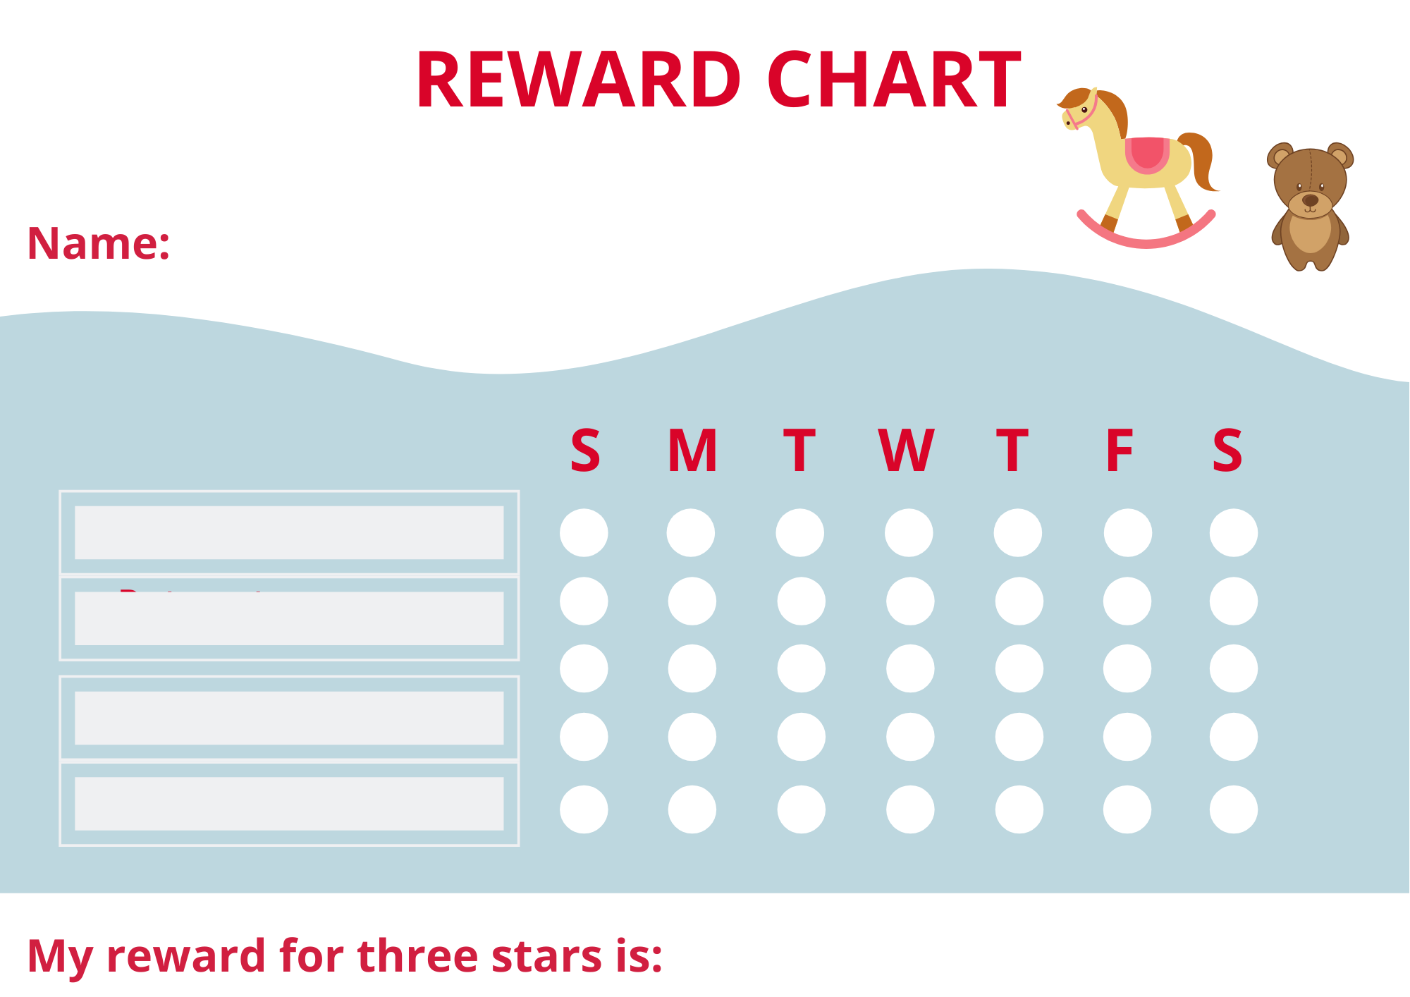
Notes:
Rewards charts can be used to help reduce negative behaviour and can be used to encourage children to do jobs and chores around the house think about what is important for your family.
Encourage your child to help make the reward chart, keep the reward chart in an easy access so that it can be seen make the goal achievable think about low-cost no cost rewards that are suitable to each individual child, remember to be consistent with the rewards, always give the reward that was promised, remember to never put a sad face or a or a cross when a child hasn't reached the expected behaviour.

